Slide 1
Fleet Reserve and Retirement
Notes:
Time Required: 70 min

Slide 2
Enabling Objectives
STATE the purpose of the Fleet Reserve
IDENTIFY personnel eligible for Fleet Reserve and retirement
IDENTIFY the duties credited towards Active Service in the Armed Forces
IDENTIFY the submission requirements for Fleet Reserve and Retirement requests
IDENTIFY the non-disability Fleet Reserve retirement procedures
IDENTIFY the steps for applying for Fleet Reserves and Retirement in NSIPS
IDENTIFY how the Date Initial Entry Military Service (DIEMS) affects retirement
LIST the military retirement plans in effect
IDENTIFY the steps to compute retainer pay
Notes:
FACILITATOR GUIDE:
Review objectives.

Slide 3
References
MILPERSMAN 1810-010: Voluntary Retirement Of Enlisted Personnel – 30 Or More Years Of Active Service
MILPERSMAN 1830-040: Transfer To Fleet Reserve And Release From Active Duty – 20 Years
MILPERSMAN 1800-020: Effective Date Of Retirement, Issuance Of Retirement Orders And Authorization
MILPERSMAN 1810-080: Enrollment In The Blended Retirement System
MILPERSMAN 1810-081: Continuation Pay For Service Members Enrolled In The Blended Retirement System
Military Compensation - Retired Pay:
https://militarypay.defense.gov/Pay/Retirement.aspx
Notes:
FACILITATOR GUIDE:
Review references.

Slide 4
References
(cont.)
Department Of Defense Financial Management Regulation (DoD FMR) 7000.14-R, Volume 7B Chapter 1
OPNAVINST 1900.2D, Transition Assistance Program
NAVADMIN 273/17, Implementation Of Retirements And Separations Functionality Within NSIPS
MyNavyHR website:
https://www.mynavyhr.navy.mil/career-management/transition/transition-tap/
Notes:
FACILITATOR GUIDE:
Review references.

Slide 5
Fleet Reserve
(FLTRES)
Provides an available reserve of experienced former members of the Regular Navy and the Naval Reserve who may be used to fill billets requiring experienced personnel in the initial stages of mobilization during an emergency or in war
Consists of military personnel who have completed 20 but less than 30 years of Active Service in the Armed Forces (ASAF)
Effective date of Fleet Reserve is the last day of the month, of the month requested after service requirements have been fully met
Guidance listed in MILPERSMAN 1830-040
Notes:
FACILITATOR GUIDE:
Fleet Reserve - An enlisted member of the naval service who has completed a minimum of 20 years of active service in the armed forces may, at his/her request, be transferred to the Fleet Reserve.
Counselor assist with the following:
Initial screening to determine Sailors eligibility.
Help Sailors verify their statement of service.

Slide 6
Fleet Reserve
Eligibility Requirements
Completion of 20 years but less than 30 years of credible service.
  (MILPERSMAN 1830-040/ DOD FMR 7000.14-R, Volume 7B, Chapter 1)
Complete current assignment or DoD tour.
E-7 through E-9 must serve 2 years in present paygrade.
Fleet Reserve Submissions at HYT gate can compete for advancement.
  Verify HYT with current MPM and NAVADMINs
Notes:
FACILITATOR GUIDE:
E-6: Can request 6-18 months from requested FLTRES date
E-7 to E-9: Can request 6-24 months from requested FLTRES date
Discuss creditable service:
The following is service creditable for Regular voluntary retirement for enlisted members:
All active service in the Uniformed Services; and
Service as a cadet or midshipman at Service academy

Slide 7
Fleet Reserve
Non-Disability
Retirement from Fleet Reserve is automatic:
  (MILPERSMAN 1820-010)
Retired List:
  Navy Personnel Command (NAVPERSCOM), Reserve Retirements Branch (PERS-912) will transfer members of the Fleet Reserve to the Retired List without application upon:
    Completion of 30 years active and inactive service.
    Upon determination that the member is not physically qualified to perform the duties of the rate held.
      Such members may, upon notification by Chief of Naval Personnel, be transferred to the Retired List, or if serving on active duty and when otherwise qualified; therefore, be placed on the Temporary or Permanent Physical Disability Retired List.
Notes:
FACILITATOR GUIDE:
Review MPM prior to briefing slide.

Slide 8
Retirement
Reference: MILPERSMAN 1810-010
Consists of military personnel who have completed a minimum of 30 years of Active Service in the Armed Forces (ASAF).
Effective date of retirement is the 1st day of the month, after the month in which service requirements have been fully met.
Notes:
FACILITATOR GUIDE:
Additional Notes:
Release from active duty is effective on the day immediately preceding the effective date of retirement.
.
HYT mandated retirements, may only be deferred if the Service member is:
hospitalized due to non-elective circumstances (i.e., acute, grave, or life threatening condition)
medical board report has been accepted by the president of a physical evaluation board for disability evaluation processing

Slide 9
Fleet Reserve/Retirement
Request
Requests for Transfer to Fleet Reserve/Retirement:
  Sailor submits request in Retirements and Separations (RnS) NSIPS self-service access.
Submit requests within the following timelines:
  E-6 and junior: 6-18 months prior to requested date
  E-7 – E-9: 6-24 months prior to requested date
  Officers: 6-9 months prior to requested date
Extraordinary Heroism:
  Credited by the Secretary concerned with extraordinary heroism in the line of duty and if the highest grade held satisfactorily by that person at any time in the armed forces is an enlisted grade, the person’s retired pay shall be increased by 10 percent of the amount determined
    Supporting documents (award citation, SECNAV memo, NAVPERS 1650/1) added to RnS request by member at time of submission
Notes:
FACILITATOR GUIDE:
E6 and below: 6–18 months prior to requested Fleet Reserve date
E7 and above: 6-24 months prior to requested Fleet Reserve date
Retirement requests should be submitted 24 months prior to requested Retirement date
Additional Notes:
All messages will be available in NSIPS
Approval can be used to complete any OBLISERV requirements to reach the authorized Fleet Reserve/Retirement date.

Slide 10
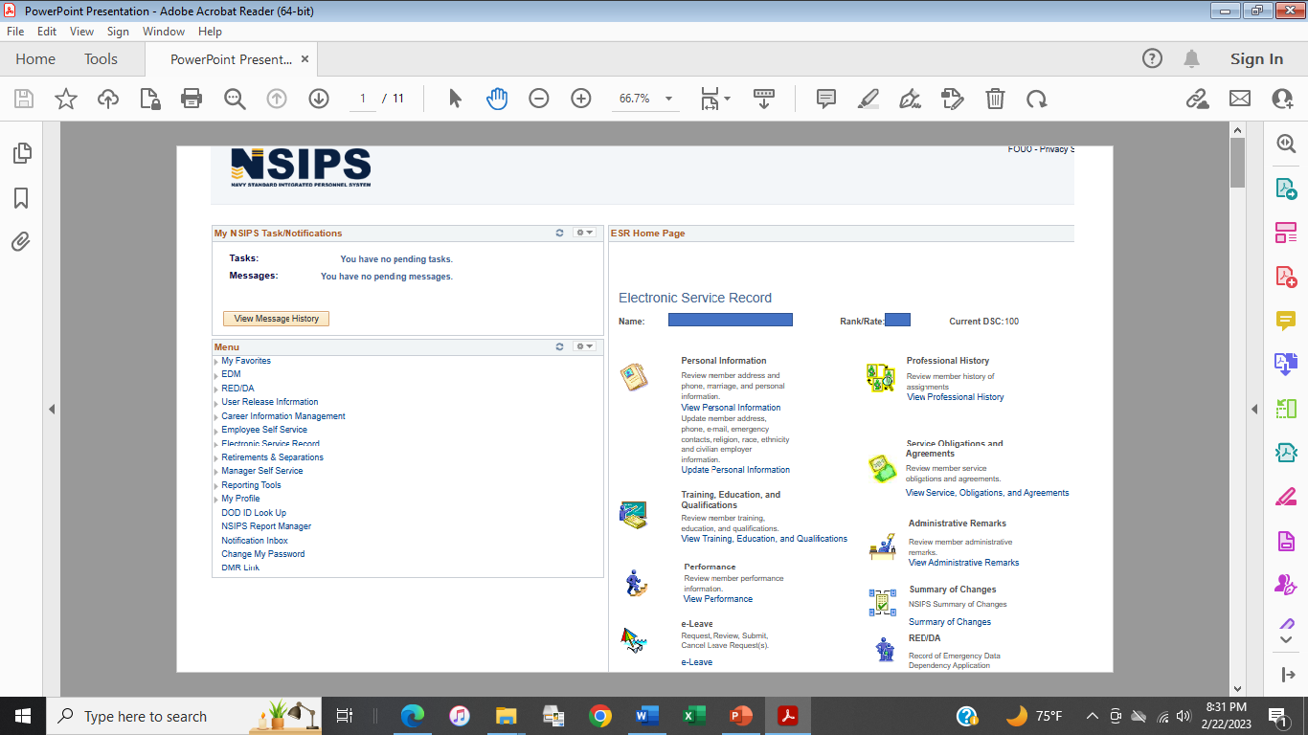
Fleet Reserve/Retirement
Planned Separation Address (PSA)
The PSA is required to complete the routing and processing of your FLTRES/Retirement request.
Employee Self Service – Task – Address Phone.
Notes:
FACILITATOR GUIDE:
Log into NSIPS if able and walk through the site as if applying for Fleet Reserves or Retirement.
Prior to applying for Retirements & Separations in NSIPS:
Click on employee Self Service to first update address and phone information in the steps on the next few slides
Steps for applying:
Click on Retirement & Separations.

Slide 11
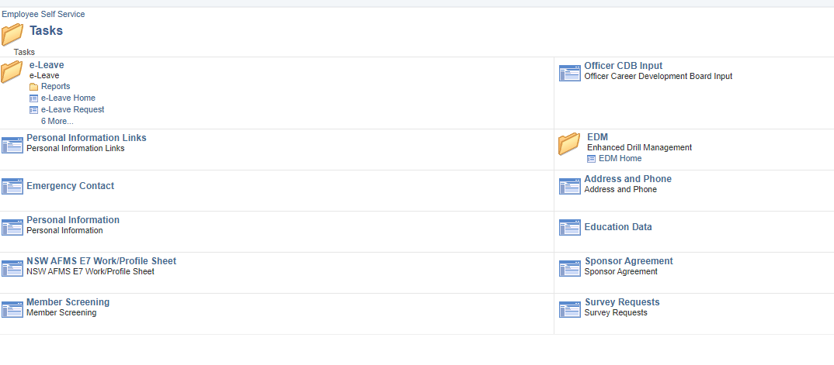
Fleet Reserve/Retirement
Planned Separation Address (PSA)
Notes:
FACILITATOR GUIDE:
Click on address and phone
Then you will hit the + sign and follow directions in next slide

Slide 12

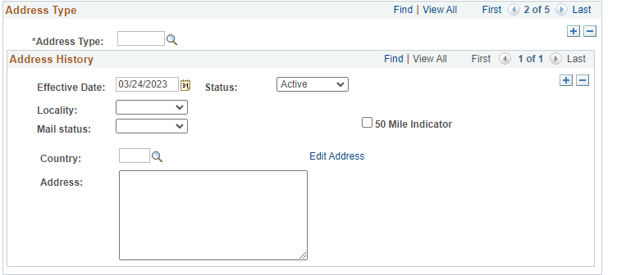
Fleet Reserve/Retirement
Planned Separation Address (PSA)
Address type: Select Planned Separation Address (PSA).
Then select Edit Address and complete the address entry.
Save when completed.
Notes:
FACILITATOR GUIDE:
To start filling out your address you will click on the magnify glass
Once it comes up you will scroll down and click on PSA (Planned Separation) *list is shown in next slide
After selecting PSA the member can complete address update by clicking edit address
NOTE: If the Sailor does not update the address prior to completing the request. Once they begin the process they will receive a message saying “Please enter a valid Planned Retirement/Separation Address, Phone, or Email link.” (Contact Information). At this time they can enter their PSA information.

Slide 13
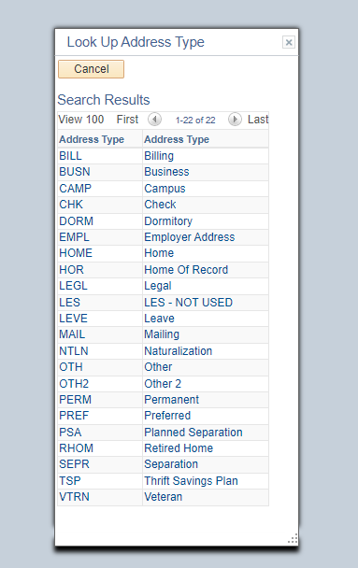
Fleet Reserve/Retirement
Planned Separation Address (PSA)
Notes:
FACILITATOR GUIDE:
This slide shows the different types of addresses the Sailor can chose from. The member will select, PSA Planned Separation.

Slide 14
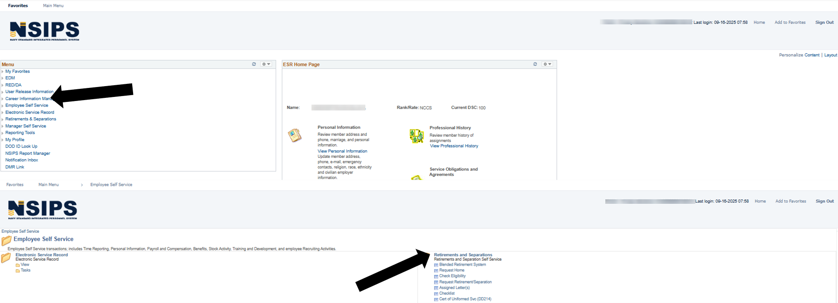
Fleet Reserve/Retirement
Request
Notes:
FACILITATOR GUIDE:
Once the Address Phone is updated. Click on Retirement/Separation Request
The following slides explain the steps for submitting request in NSIPS

Slide 15
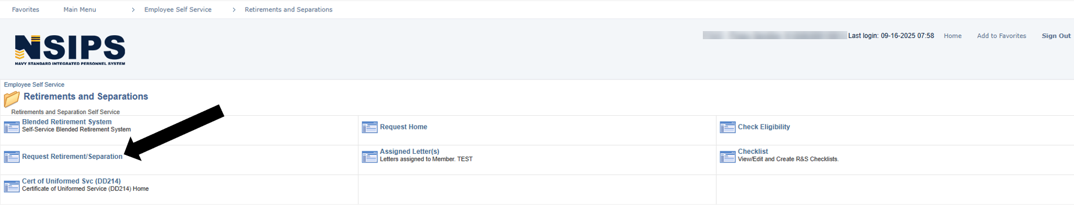
Fleet Reserve/Retirement
Request
Notes:
FACILITATOR GUIDE:
Once the Address Phone is updated. Click on Retirement/Separation Request
The following slides explain the steps for submitting request in NSIPS

Slide 16
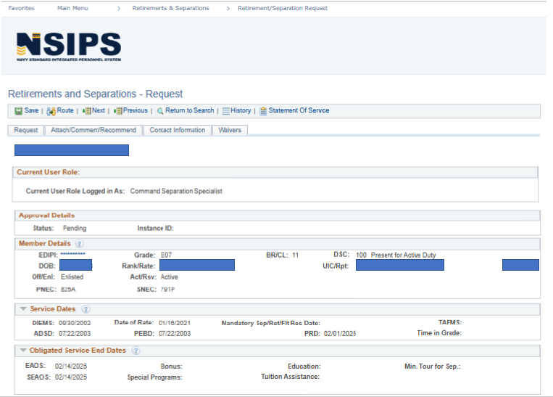
Fleet Reserve/Retirement
Request
Notes:
FACILITATOR GUIDE:
This page will appear once you click on Retirement/Separation Request.
Discuss the tabs going across from Save, Route, Next, Previous, Return to Search, History, Statement of Service (not listed is Reference Material and Modify/Cancel which will show up on members request).
Route:
Will give the member the ability to route request to Command Separation Specialist or Command Reviewer depending on how routing is set up for command
Command Separation Specialist will route based on command routing process
Reporting Senior will route to NPC for processing
Statement of Service will give member break down of total service
Explain the tabs for Request, Attach/Comment/Recommend
Upload Attachments:
This tab gives the member the ability to attach supporting documents to support any waivers or anything that is significant for their request. This is the same area the member will find the Approval Letter.
Comments and Recommendations:
This tab allows members of COC to input comments and recommendations on the members request. It also shows the user role and who made the comment on the request.
Contact Information:
This tab will show contact information that was updated prior to applying for Retirement/Separation.
Command Contact Information will be the person who will be contacted regarding the request. This is normally the Command Career Counselor or Command Separation Specialist.
Reporting Senior will be the Commanding Officer or Officer in Charge.

Slide 17
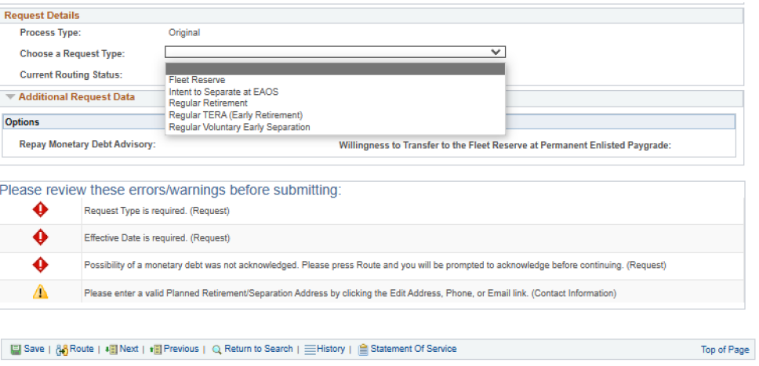
Fleet Reserve/Retirement
Request
Once you Choose a Request Type the errors/warnings below will change based on type of request as you will see in the following slides.
Notes:
FACILITATOR GUIDE:
Once you scroll down to fill out the request you will come to “Request Details.” “Request type” will determine the errors/warnings you will receive.
The following slides are examples of different errors/warnings a Sailor will see based on their request type.
Note: Explain the errors/warnings will change as the member fills out the request.

Slide 18
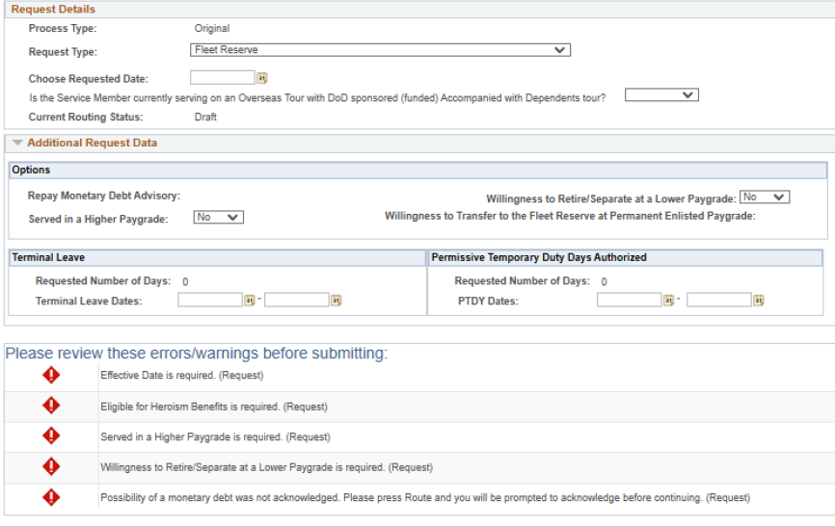
Fleet Reserve/Retirement
Request
Notes:
FACILITATOR GUIDE:
Once you select a request type; fill out the blocks that pertains to the request .
As you start to fill out the request some errors/warnings will turn green with a check mark or a yellow triangle with exclamation mark.
Note: Until the member completes the request and routes it; it will stay in members record as a draft. When the request is in "draft mode" it can only be edited by the member but can be viewed by the Command Separation Specialist.
Note: Explain the errors/warnings will change as the member fills out the request.

Slide 19

Fleet Reserve/Retirement
Request
Notes:
FACILITATOR GUIDE:
Note: Please ignore the eligibility results on this slide since the EAOS/SEAOS are too far out to submit request.
The purpose of this slide is to show how any errors/warnings for the request will be listed at the bottom of the page.
Note: Explain the errors/warnings will change as the member fills out the request.

Slide 20

Fleet Reserve/Retirement
Request
Notes:
FACILITATOR GUIDE:
Errors/Warnings
Member will receive a “Failed Eligibility” if the request submitted is outside of members window for applying.
Note: Possibility of Monetary debt was not acknowledged. Press "Route" and you will be prompted to acknowledge before continuing.
- Explain that this error may apply to Sailors based off of leave sell back, debt for any previous travels not completed, or if member may be under/overpaid for the month if retirement/separation.
Note: Error/warning - Requested date occurs after EAOS (MM/DD/YYYY) and SEAOS (MM/DD/YYYY) dates.
-With this error a member may require more service on contract to meet retirement or fleet reserve date. Explain the process the Sailor will complete with the CCC if this comes up i.e., extension process.

Slide 21
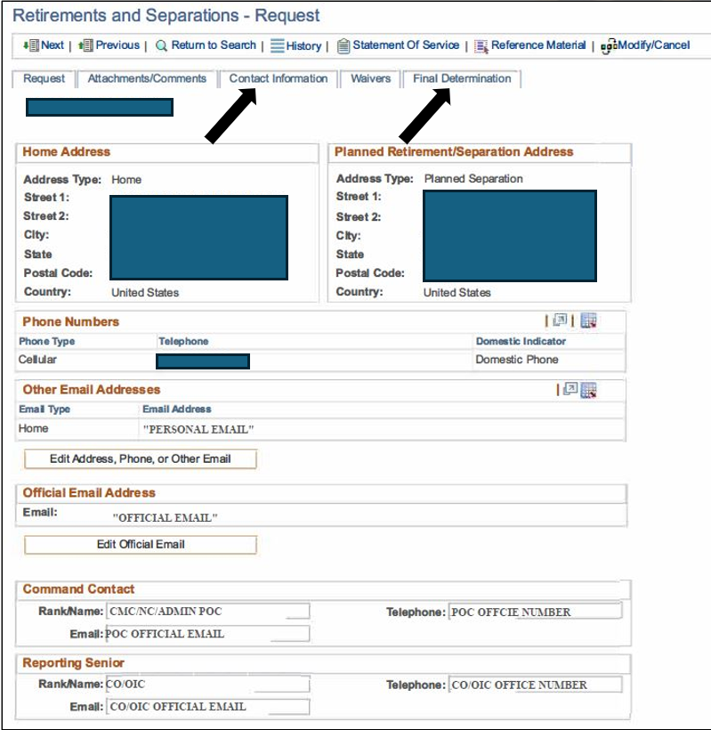
Fleet Reserve/Retirement
Request
Prior to submission or routing
Verify/Update Contact Information:
  Planned separation address
  Phone number
  Personal email
  Official email
  Command point of contact
  Reporting senior
Messages from BUPERS/NPC:
  Approval will be forwarded NLT 120 days prior to requested date via NSIPS on Member’s Fleet Reserve Request (attachments section)
Notes:
FACILITATOR GUIDE:
Errors/Warnings
Member will receive a “Failed Eligibility” if the request submitted is outside of members window for applying.
Note: Possibility of Monetary debt was not acknowledged. Press "Route" and you will be prompted to acknowledge before continuing.
- Explain that this error may apply to Sailors based off of leave sell back, debt for any previous travels not completed, or if member may be under/overpaid for the month if retirement/separation.
Note: Error/warning - Requested date occurs after EAOS (MM/DD/YYYY) and SEAOS (MM/DD/YYYY) dates.
-With this error a member may require more service on contract to meet retirement or fleet reserve date. Explain the process the Sailor will complete with the CCC if this comes up i.e., extension process.

Slide 22
Fleet Reserve/Retirement
Request (cancel/modify)
To cancel or modify a previously approved request processed in NSIPS RnS, the member will access the request and select either "modify" or "cancel" and reroute accordingly
To cancel or modify a previously approved request processed through NSIPS CIMS, CCCs should email an approved/signed Personnel Action Request (1306/7) to Enlisted_Active_Duty_Retirements@navy.mil for processing
Notes:
FACILITATOR GUIDE:
None.

Slide 23
Retirement Ceremonies
MILPERSMAN 1800-010
Ceremony:
  Is a Sailor’s choice
  May be sponsored by Sailor’s last permanent duty station, or can host their own
  Is assigned a ceremony coordinator if command sponsored
  Must request to CO in writing if command sponsored
CCC responsibilities:
  Make sure all documents are prepared
  Make sure command issues U.S. flag on behalf of SECNAV
    Authorized to use OPTAR funds to procure flags
  Make yourself available to coordinator
  Support with ordering letters of appreciation
Notes:
FACILITATOR GUIDE:
None.

Slide 24
Retirement Plans
Date of Initial Entry into Military Service (DIEMS)
Date first enlisted/commissioned into any component of the armed forces:
  Has no bearing on longevity for pay or years of service
  Should never change; not adjusted for broken time or time lost
  Determines a member’s retirement plan
Notes:
FACILITATOR GUIDE:
None.

Slide 25
Retirement Plans
Retirement Calculators
  https://militarypay.defense.gov/Calculators/
Retirement Plan | Criteria to Receive
Final Pay | Entry before September 8, 1980
High-36 | Entry on or after September 8, 1980, but before August 1, 1986 OR Entered on or after August 1, 1986, and did not choose the Career Status Bonus and REDUX retirement system
CSB/REDUX | Entered on or after August 1, 1986, but before January 1, 2003 AND elected to receive the Career Status Bonus
Blended Retirement System (BRS) | Entered the Uniformed Services for the first time on or after January 1, 2018 (automatic enrollment), or entered before December 31, 2017 and elected to opt into BRS during the opt-in period
Disability | Determined medically unfit for continued service with a DoD disability rating of at least 30%
Notes:
FACILITATOR GUIDE:
Review retirement plans.
1. Final Pay: Defined Benefit that equals 2.5% times the number of years of service times the member’s final basic pay on the day of retirement.
2. High-36: Defined Benefit that equals 2.5% times the number of years of service times the average of the member’s highest 36 months of basic pay.
3. Redux: Career Status Bonus $30,000 lump sum payment at 15th year of service with obligation to serve through 20 years + defined benefit.
Defined Benefit is:
(a) Prior to age 62: 2.5% times the number of years of service minus 1.0% for each year of service less than 30, times the average of the member’s highest 36 months of basic pay
(b) At age 62 and after: 2.5% times the number of years of service times the average of the member’s highest 36 months of basic pay
4. BRS: Blended defined benefit and defined contribution plan.
Defined Contribution:
All covered members receive a Government contribution that equals 1% of basic or inactive duty pay to a tax-advantaged retirement account (Thrift Savings Plan (TSP)) after 60 days following the entry into Uniformed Service. Additionally, covered members have the ability to receive up to an additional 4% matching contribution from the Government to TSP beginning after 2nd year of service through 26th year of service.
Defined Benefit:
Members who otherwise qualify for a retirement based on longevity of service will also receive a defined benefit that is 2.0% times the number of years of service times the member’s highest 36 months of basic pay.
5. Disability: Retirement plan that equals to: Retired Pay Base* times Multiplier %**
*Retired Pay Base – determined under Final Pay, High-36, or BRS depending on military service date of entry.
**Multiplier Percentage can be either:
Member’s percentage of disability determined by the military service
Years of creditable service times 2.5% or 2.0% (Based on whether the member was a participant in one of the legacy retirement programs or the Blended Retirement System prior to the disability)

Slide 26
Retirement Plans
Comparisons
Years of Service | Final/High 3% | BRS % | REDUX%
20 | 50 | 40 | 40
21 | 52.5 | 42 | 43.5
22 | 55 | 44 | 47
23 | 57.5 | 46 | 50.5
24 | 60 | 48 | 54
25 | 62.5 | 50 | 57.5
30 | 75 | 60 | 75
35 | 87.5 | 70 | 87.5
40 | 100 | 80 | 100
41 | 102.5 | 82 | 102.5
Notes:
FACILITATOR GUIDE:
Review chart.

Slide 27
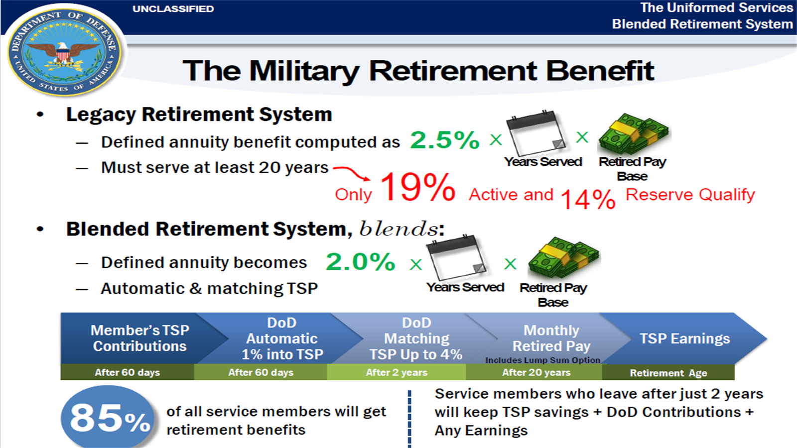
Notes:
FACILITATOR GUIDE:
Visual of current retirement systems.

Slide 28
Retirement Plans
Plans breakdown
HIGH 3 | BRS
DIEMS on or after 8 Sep 80 | DIEMS on or after 1 Jan 2018 or entered before December 31, 2017 and elected to opt into BRS during the opt-in period
2.5% times the number of years of service times the average of the member’s highest 36 months of basic pay | 2.0% times the number of years of service times the member’s highest 36 months of basic pay
+2.5% every year over 20 years | TSP matching up to 5%
 | Continuation Pay
Notes:
FACILITATOR GUIDE:
None

Slide 29
Retirement Plans
Continuation Pay
One-time mid-career incentive pay in exchange for an agreement to perform 4 years of additional obligated service, paid at member’s 12th year of service mark
  Designed to incentivize service members to obligate for an additional 4 years of service until eligibility for a regular or non-regular retirement
  Eligible to elect between 11 ½-12 years of service only
    After 12 years, members are no longer eligible to elect for bonus
  NSIPS sends member notification at 11 ½ year of service mark, then at 90 days prior to 12 year of service mark, reminding members that they are coming up on the CP election deadline
    Ensure Sailors contact information on NSIPS is correct
  Service members have two options for CP payment:
    (1) Lump sum, or
    (2) In a series of equal installment payments, not to exceed 4 annual payments occurring over 4 consecutive years
Notes:
FACILITATOR GUIDE:
-Member does not have to reenlist on 12 year of service mark, just agree to obligate to 16 years of service via extension/reenlistment
-Sailors who fail to obligate to 16 years of service must pay back CP day for day of unserved time past 12 years of service mark

Slide 30
Knowledge Check
What date determines a Sailor’s retirement plan?
When are Sailor’s eligible for continuation pay?
Which retirement plans are Sailors currently enrolled in?
How early can a Sailor request transfer to the Fleet Reserve?
In what system does a Sailor request Fleet Reserve/Retirement?
What is the effective date of Fleet Reserves and Retirement?
Is a retirement ceremony mandatory?
Notes:
ANSWERS:
DIEMS date
Eligible prior to reaching 12 years
High 3 and BRS
6-18 months out (E-6); 6-24 months out (E-7 through E-9)
NSIPS RnS
Fleet Reserves is end of month and Retirement is on the first of the following month for Master Chiefs at 30+ and Officers
No

Slide 31
Summary and Review
In this lesson we discussed:
  Fleet Reserve and retirement purpose and eligibility
  Creditable service
  Submission of Fleet Reserve/Retirement request
  Non-disability Fleet Reserve retirement procedures
  LIST the factors affecting retirement pay
  DIEMS effects on retirement
  Current military retirement plans
  Computed retainer pay for the two retirement systems

Slide 32
Questions?

